Slide 1

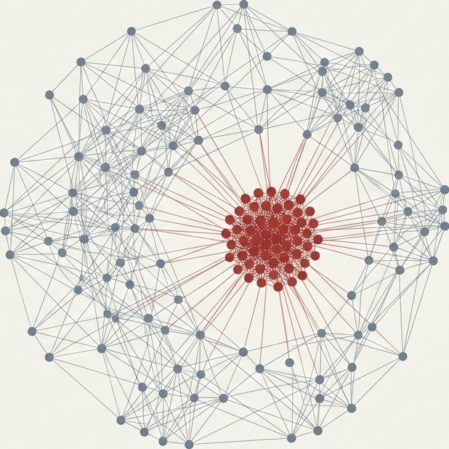
Real Impact-Factor Analysis Of Academic Journals
Final Project Phase A - 26-1-R-17
Authors: Heba Abu Qandil & Orian Haziza
Supervisors: Dr. Renata Avros, Prof. Zeev Volkovich

Slide 2
Introduction
Academic research quality is often judged using quantitative metrics.
The most common of these is the Journal’s Impact Factor (IF).
IF affects: Funding decisions, Tenure and promotions, Journal prestige.
Therefore, accuracy and reliability of IF are critical.

Slide 3
The Hidden Manipulation in Citation Networks
The Manipulation: The network is compromised by ’Citation Cartels’, coercive citations, and excessive self- citations.
The Problem: Traditional IF calculate influence using raw, unfiltered data.
The Scale: Research (Prabha, 1983) indicates that more than two-thirds of references in a typical paper may be superfluous.
Existing analysis misses these invisible cracks

Slide 4
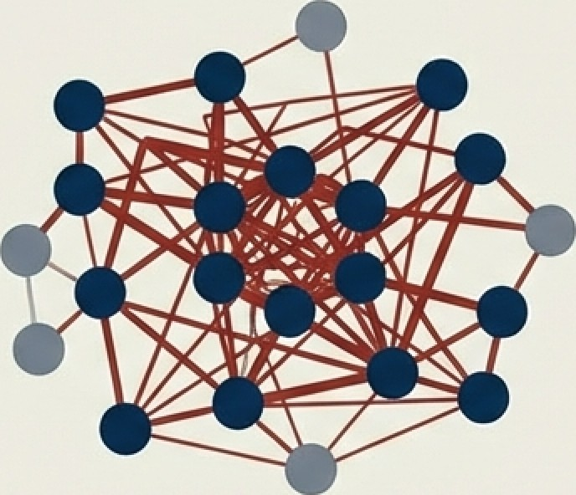
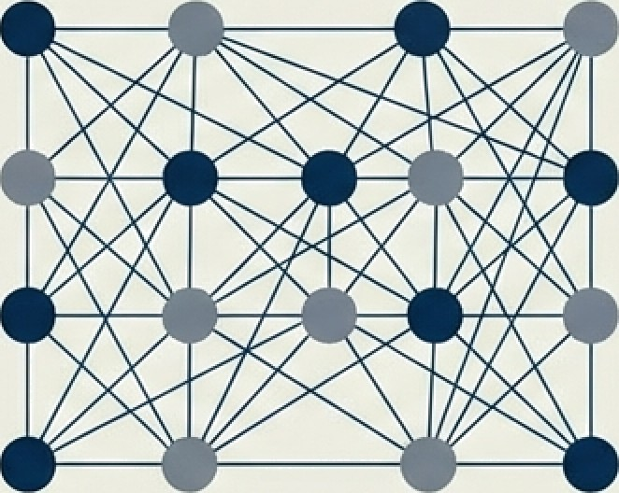
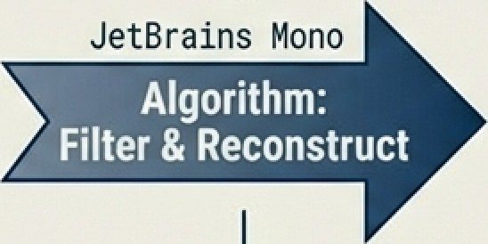
Our Mission: Refining the Impact Factor
Raw Data Reliable Network
Generate an “Improved Impact Factor“ -a metric that reflects true scientific influence by emitting non-relevant citations.

Slide 5

Impact Factor
The Impact Factor is a measure reflecting the yearly mean number of citations to recent articles published in a specific journal. This metric serves as the decisive factor in academic promotion and research funding.
Because the stakes are so high, the incentive to game the system is immense.
Calculation:

Slide 6
The Core Hypothesis: Stability vs. Fragility
Genuine Citations Manipulated Citations
Fragile- Lacks structural reinforcement. Fails reconstruction when the network is perturbated.
Robust and steady under network perturbations

Slide 7
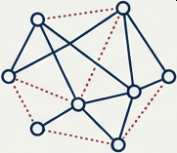
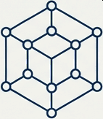



Methodology: A Stability-Test for Data
Time loop
Perturbation
Randomly remove a fraction (Fr) of edges to create temporary graph G_T.
Embedding
Learn graph structure using GraphSAGE & Node2vec embedding models.
Predict
Attempt to reconstruct removed links based on embeddings.
Validate
Compute an Improved IF using only the reliable citation network.
Perturbation loop

Slide 8
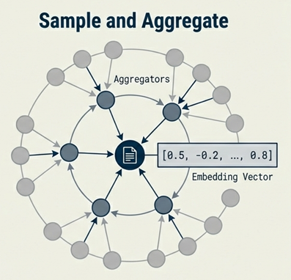
GraphSAGE Embedding
Understanding context through Inductive Learning-
GraphSAGE generates node embeddings by sampling and aggregating features from a node’s local neighborhood.
Sampling- selecting a fixed-size subset of a node’s neighbors
Aggregating- combining the sampled neighbors’ feature vectors (e.g., by mean, pooling functions) into a single representation that summarizes the node’s local neighborhood
Why it fits: It is designed for large, evolving graphs and can generalize to nodes unseen during training. It captures the local “fingerprint” of a citation context.

Slide 9
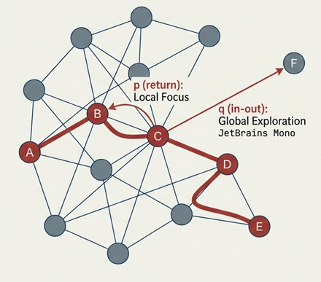




Node2vec Embedding
Generates node embeddings by simulating multiple random walks on the graph and treating them as sentences. These walks are used as input to the Skip-gram model, which learns embeddings by predicting a node’s context within a sentence.
Key Parameters:
Return parameter (p): Controls revisiting nodes.
In-out parameter (q): Controls moving outward.
Why it fits: Balances local connectivity with global structural equivalence

Slide 10
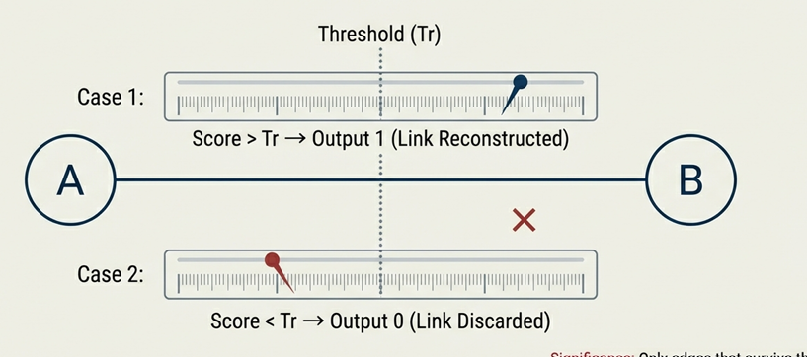
Link Prediction
Objective: To determine whether an edge should exist between two nodes Significance: Only edges that survive this test across multiple perturbations are deemed as a part of the Reliable Network.

Slide 11
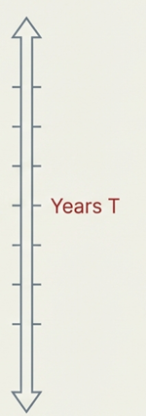

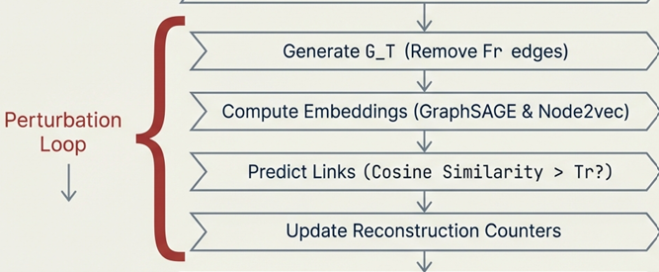

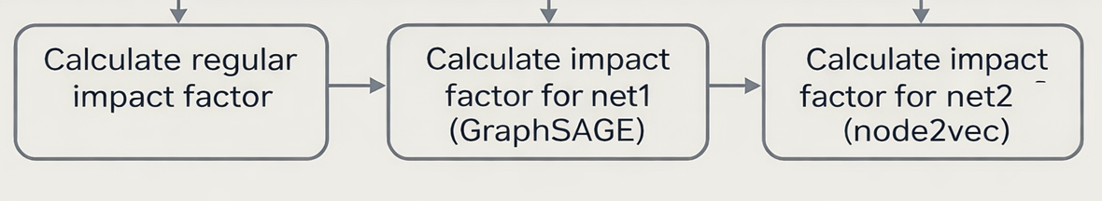
The Algorithm Execution Cycle
unreliable
Output:

Slide 12
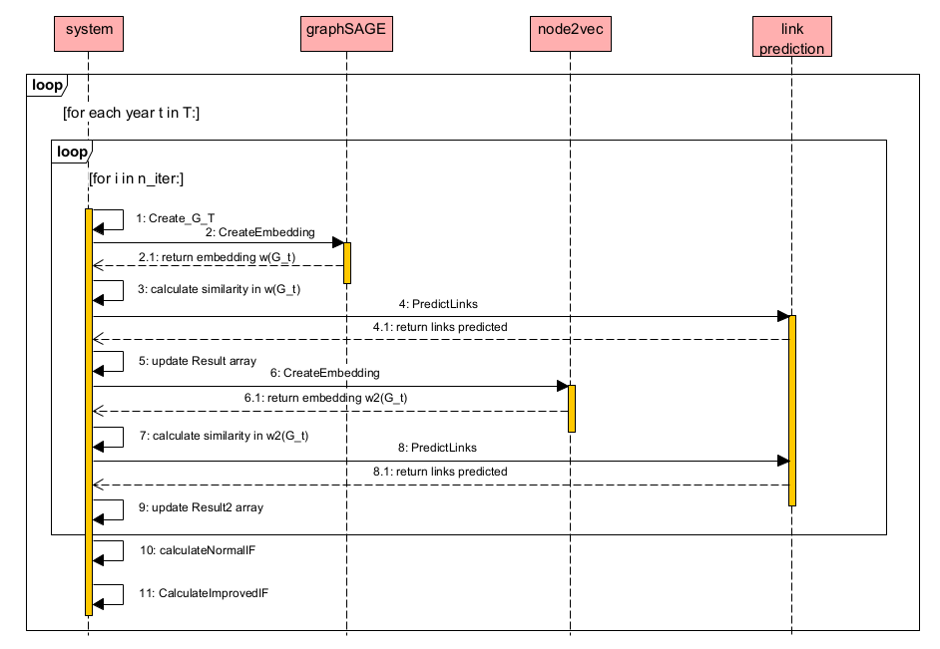
sequence diagram

Slide 13
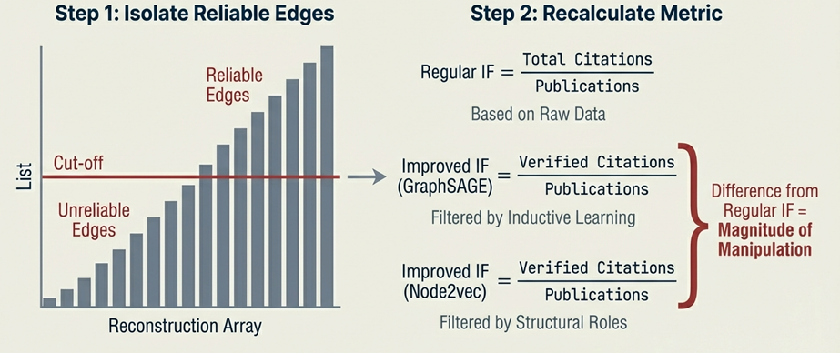
Deriving the Improved Impact Factor

Slide 14
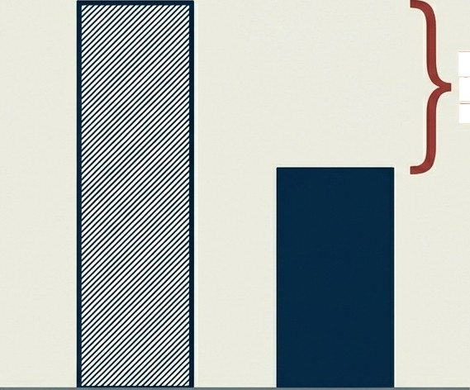
Expected Outcomes and Impact
We anticipate the Improved IF will be lower than the Regular IF. This gap represents the manipulation we successfully filtered out.
The Gap: Noise, Cartels, and Errors
The Value: A transparent, complementary tool for research evaluation, rewarding genuine knowledge patterns over gaming strategies.
Regular IF
Improved IF

Slide 15
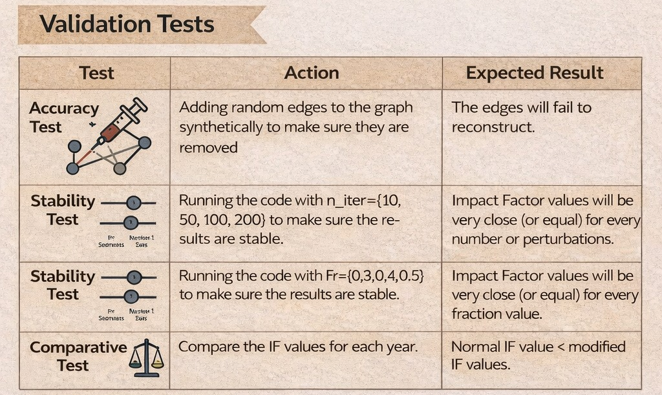
Some Validation and Testing Plan

Slide 16

Some Validation and Testing Plan

Slide 17
Thank you for listening
References
[1] Avros, R., Farfel, G., & Volkovich, Z. (2025). A Nested Structure of Anomalies in Academic Publication Citations. In Proceedings of the 14th International Conference on Data Science, Technology and Applications (DATA 2025), pages 761-768.
[2] Avros, R., Toledano Kitai, D., & Volkovich, Z. (2025). Citation Steadiness Analysis with GraphSAGE Approach. Proceedings of the 14th International Conference on Data Science, Technology and Applications (DATA 2025), pages 769-777.
[3] Avros, R., Keshet, S., Toledano Kitai, D., Vexler, E., & Volkovich, Z. (2023). Detecting Pseudo-Manipulated Citations in Scientific Literature through Perturbations of the Citation Graph. Mathematics, 11, 3820.
[4] Grover, A.; Leskovec, J. Node2vec: Scalable Feature Learning for Networks. Proceedings of the 22nd ACM SIGKDD International Conference on Knowledge Discovery and Data Mining, KDD ‘16, San Francisco, CA, USA, 13–17 August 2016; pp. 855–864.
[5] Hamilton, W. L., Ying, Z., & Leskovec, J. (2017). Inductive representation learning on large graphs. Advances in Neural Information Processing Systems (Vol. 30). Curran Associates, Inc.
[6] Prabha, C. G. (1983). Some aspects of citation behaviour: A pilot study in business administration. Journal of the American Society for Information Science, 34(4), 202 206

